Slide 1

Product Analysis Sarah Shaaban

Slide 2

Executive summary
Purpose of analysis: to recommend which product (Point-of-Sale, Payment Pages, Payment Requests) deserves increased resource allocation for future growth.
Dataset: transaction data
Time Period: (Jan 1 - Dec 31, 2021)

Slide 3
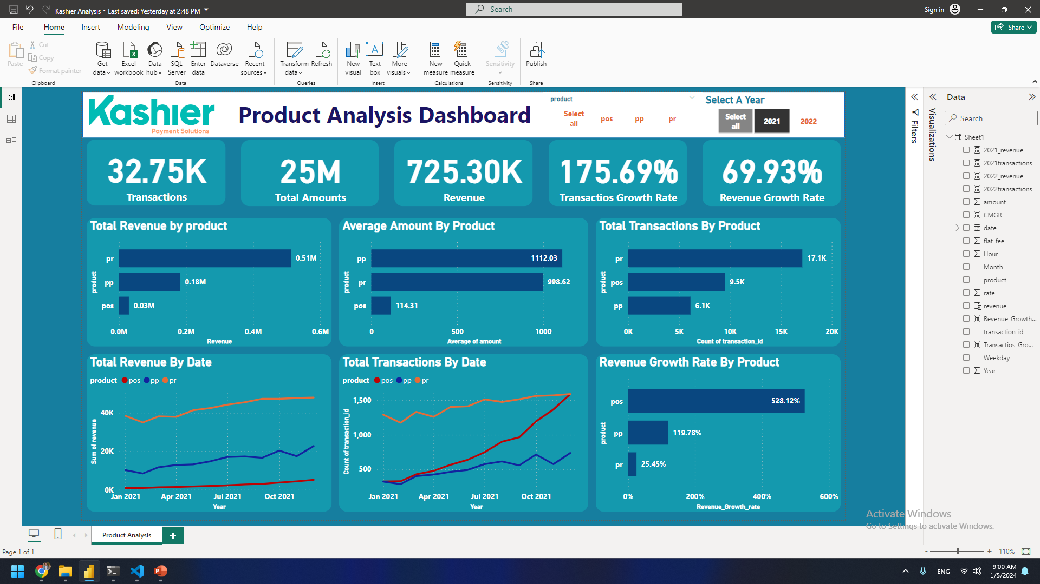
Analysis
1.Average of Amount By transactions:
Visualizations and calculations reveal:
Payment Pages:
Highest average of amount per transaction.
Payment Requests:
Second highest average of amount per transaction (Almost near to pp).
Point-of-Sale:
Lowest average Amount per transaction.

Slide 4
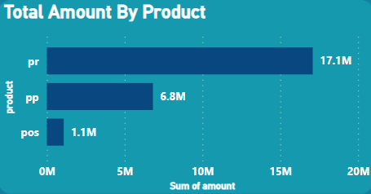
Analysis
Revenue and Total Amount per transaction:
Payment Requests:
Highest total amount for 2021 and highest number of transactiosn which led to highest revenue
Payment Pages:
Second Highest total amount for 2021 and second highest number of transactiosn which led to second highest revenue.
Point-of-Sale:
Lowest total amount for 2021 and lowest total number of transactiosn which led to lowest revenue

Slide 5
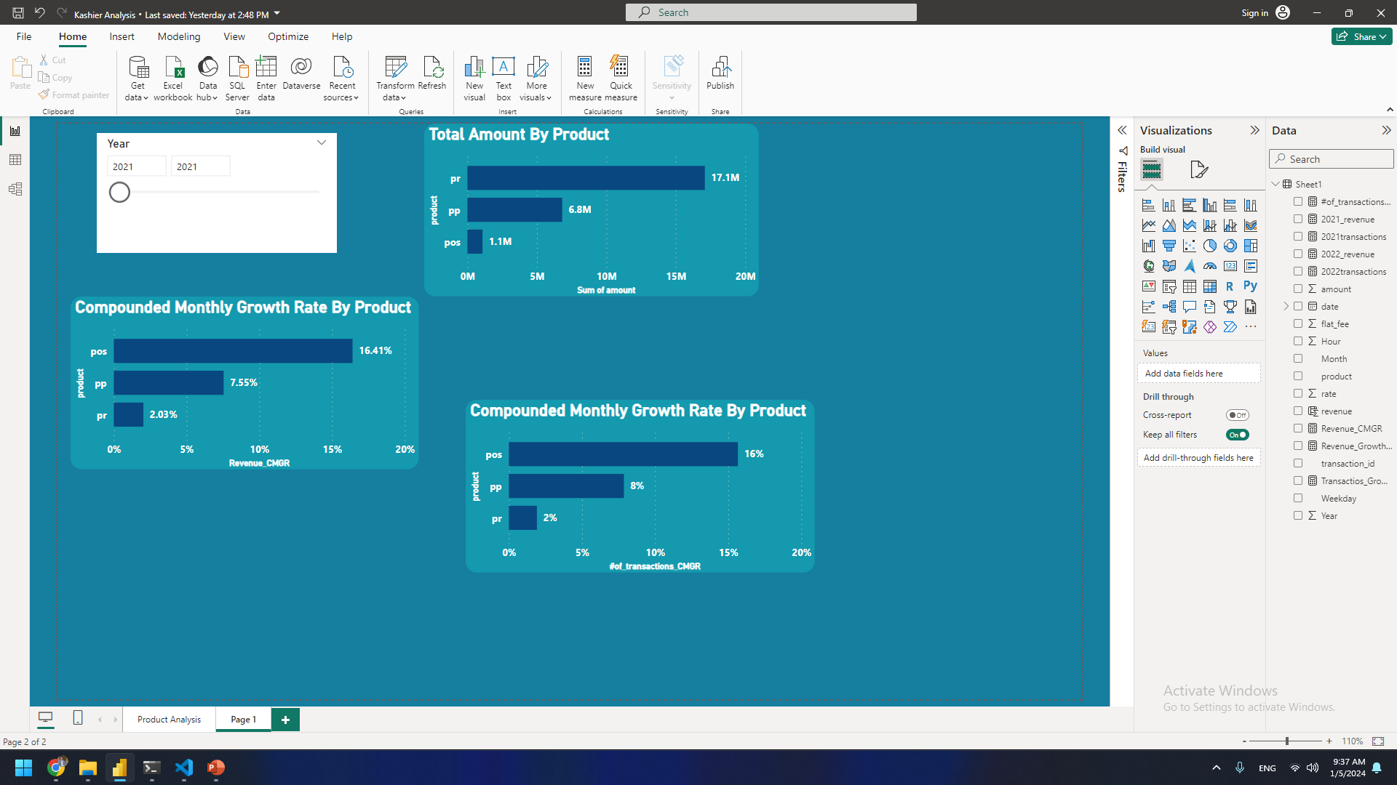
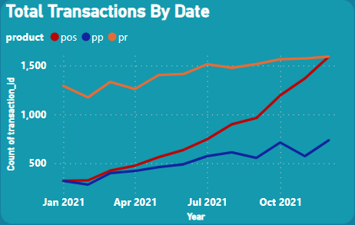
Analysis
3.Growth Potential:
Metrics growth rate shed light on potential:
Point-of-Sale:
During 2021 had the highest compounded monthly
growth rate of 16.41%
Payment Pages:
Has second highest CMGR of 7.55%.
Payment Requests:
Has the Lowest CMGR of 2.03% which is almost constant .

Slide 6
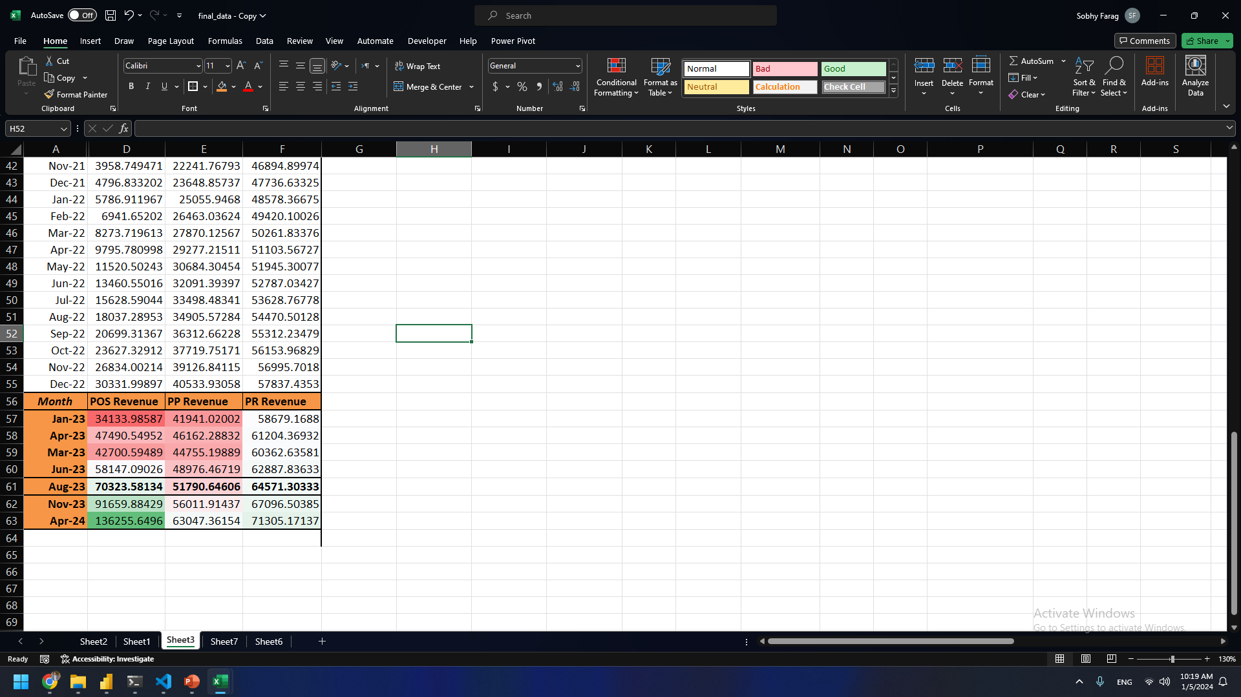
Analysis
4. Regression analysis for 2021 -2022 data
The Regression analysis shows that POS will have the highest revenue by August 2023

Slide 7
Recommendations:
Increase marketing and development efforts for Payment Pages to capitalize on existing growth momentum.
Maintain support for Payment Requests while focusing on specific high-value customer segments.

Slide 8
Conclusion
By aligning resource allocation with data-driven insights, Kashier can prioritize the product with the highest potential for sustainable and scalable growth, solidifying its position in the competitive payment solutions market.

Slide 9
Next Steps:
Develop a detailed implementation plan for each product based on the recommendations.
Monitor and track progress against identified metrics to measure success.
Regularly revisit and adjust strategies based on updated data and market trends.

Slide 10
THANK YOU!

